Slide 1
NBAC TSC Slides 30 January 2025 Meeting

Slide 2
30 JAN 2025 NBAC TSC Agenda
1:00 NBAC Co-Chair Opening Remarks – Mr. Kamran Atri & Thomas Krul
Next PGB Meeting, today,30 Jan 2025, 2-4 PM
Microsoft Teams 30 January PGB meeting 2-4 PM EST.
Join the meeting now
Meeting ID: 993 967 584 930
Passcode: JTiu7a
Dial in by phone
+1 410-874-6749,,296683050# United States, Odenton
Find a local number
Phone conference ID: 296 683 050#
Current PGB Members
2025 NBAC Monthly Meeting calendar posted – last Thursday of every month 1-2 PM Eastern Time
https://lists.oasis-open-projects.org/g/niemopen-nbactsc/calendar
NBAC Issues Kanban Board: https://github.com/orgs/niemopen/projects/7/views/2
1:10 NIEM Management Office (NMO) Update – Ms. Katherine Escobar
NIEMOpen NDR v6.0 PSD01 – simple majority vote - PGB notified of vote, 6 Jan 2025, vote conducted week of 20 Jan 2025 - APPROVED
NIEM Model v6.0 PS02 – special majority vote – PGB notified of vote, 27 Jan 2025, vote anticipated week of 10 Feb 2025
“Special Majority Vote” is a vote in which at least 2/3 (two thirds) of the eligible voters vote “yes” and no more than 1/4 (one fourth) of the eligible voters vote “no”. These numbers are based on the total number of eligible voters in the (PGB. Abstentions are not counted. For example, in a PGB in which there are 30 Voting Members, at least 20 Voting Members must vote “yes” for a motion to pass; but if 8 or more vote “no” then the motion fails. All Special Majority Votes must be conducted via electronic ballot by the OASIS OP Administrator.
1:20 NTAC Update – Dr. Scott Renner
Model Update v6.0 & API 2.0 - Christina Medlin not available but placed her API slides in back-up.
1:30 Communications & Outreach NMO Sub-Committee update – Paul Wormeli
1:35 Community Updates - all
1:40 Questions/Final Remarks
Slides available at 30 January Minutes folder, NBAC Admin Repo
https://github.com/niemopen/nbac-admin/tree/main/nbac-meeting-minutes

Slide 3
Venue
Microsoft Teams 30 January 2025 PGB Meeting
PGB Meeting
30 January 2025
Virtual Meeting 2-4 PM EST
Virtual: MS TEAMS
Microsoft Teams NIEMOpen PGB Meeting Need help?
Join the meeting now
Meeting ID: 993 967 584 930
Passcode: JTiu7a
Dial in by phone
+1 410-874-6749,,296683050# United States, Odenton
Find a local number
Phone conference ID: 296 683 050#
For organizers: Meeting options | Reset dial-in PIN
PGB Minutes & documents: https://github.com/niemopen/oasis-open-project/tree/main/pgb-meeting-minutes

Slide 4
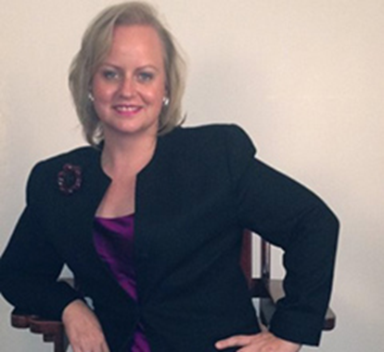
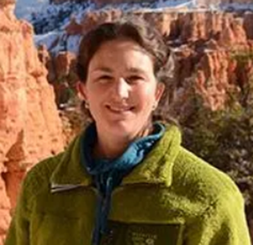

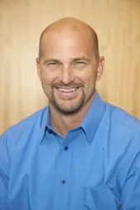
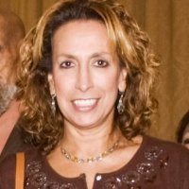
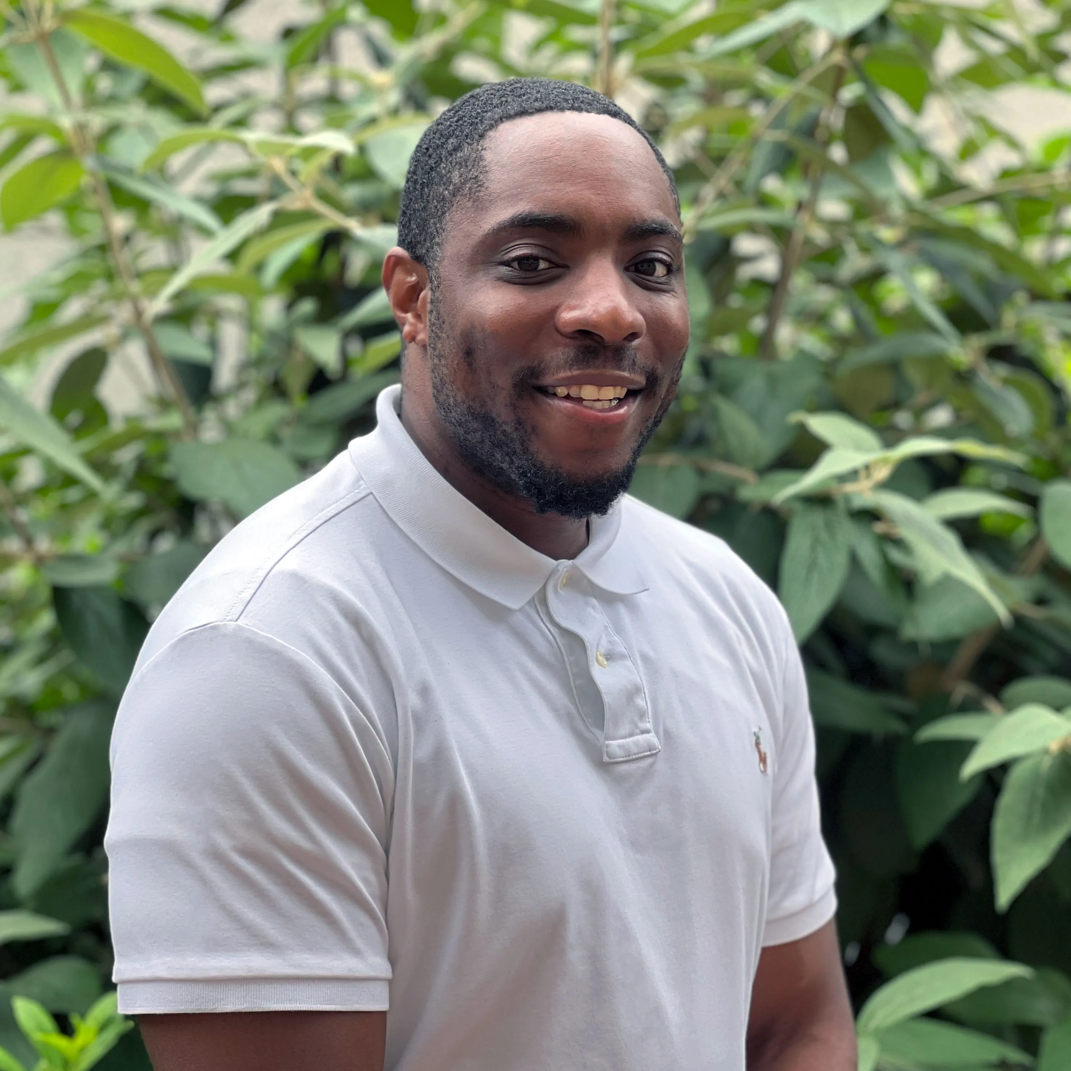
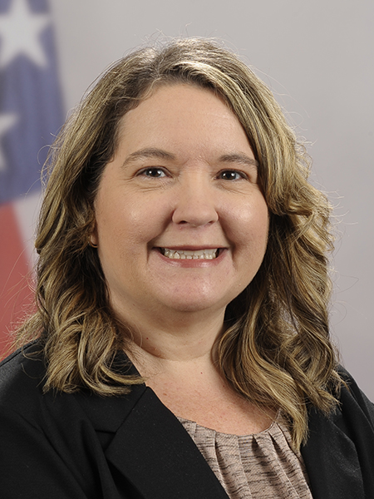
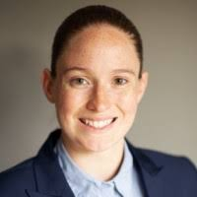
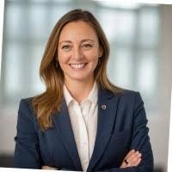

PGB APPOINTED VOTING MEMBERS
Ms. Katherine Escobar
PGB Chair
Deputy Division Chief, Data and Standards Division at Joint Staff J6 and NIEM Managing Director
Ms. Christina Bapst-Stump
Science and Technology Directorate, US Department of Homeland Security
Mr. Gary Egner
Director Business Development, Equivant
Mr. John Wandelt
Principal Research Scientist, Georgia Tech Research Institute
Ms. Maria Cardiellos
Executive Director
Integrated Justice Information Systems Institute
Mr. Payton Lamb
Data Engineer
Commonwealth of Virginia
Office of the secretary of Administration
Office of Data Governance and Analytics
Ms. April Mitchell
FBI It Specialist and Technical Lead of Data Standards in the Criminal Justice Information Services (CJIS) Division
Ms. Erin Partin
Data Scientist, Office of the Principal Deputy Director, National Institute of Justice (NIJ)
Ms. Erica Smith
Data Scientist, Unit Chief – Law Enforcement Incident-Based Statistics Unit, Bureau of Justice Statistics(BJS)
Mr. Tom Welch Director of Information Technology
OHIO HIDTA – Including Northern KY & Western PA
Notes:
Open Project Rules - OASIS Open (oasis-open.org)
5.1 Overall guidance for the Project is provided by its Project Governing Board (or PGB). The PGB is composed of one voting member from each Project Sponsor who elects to appoint a PGB member, and (a) if the PGB has one or more Technical Steering Committees, one voting expert representative from each TSC, elected or appointed by that TSC, or (b) otherwise, the PGB may appoint at least one and no more than two voting expert representatives from its community of contributors. The PGB may create additional non-voting PGB member seats for expert representatives to be elected by the TSC or appointed by the PGB. The PGB membership of all such members of any type is conditioned on satisfaction of the CLA requirement of Section 5.2. Voting status on the PGB may be affected by the provisions of Section 5.7.

Slide 5

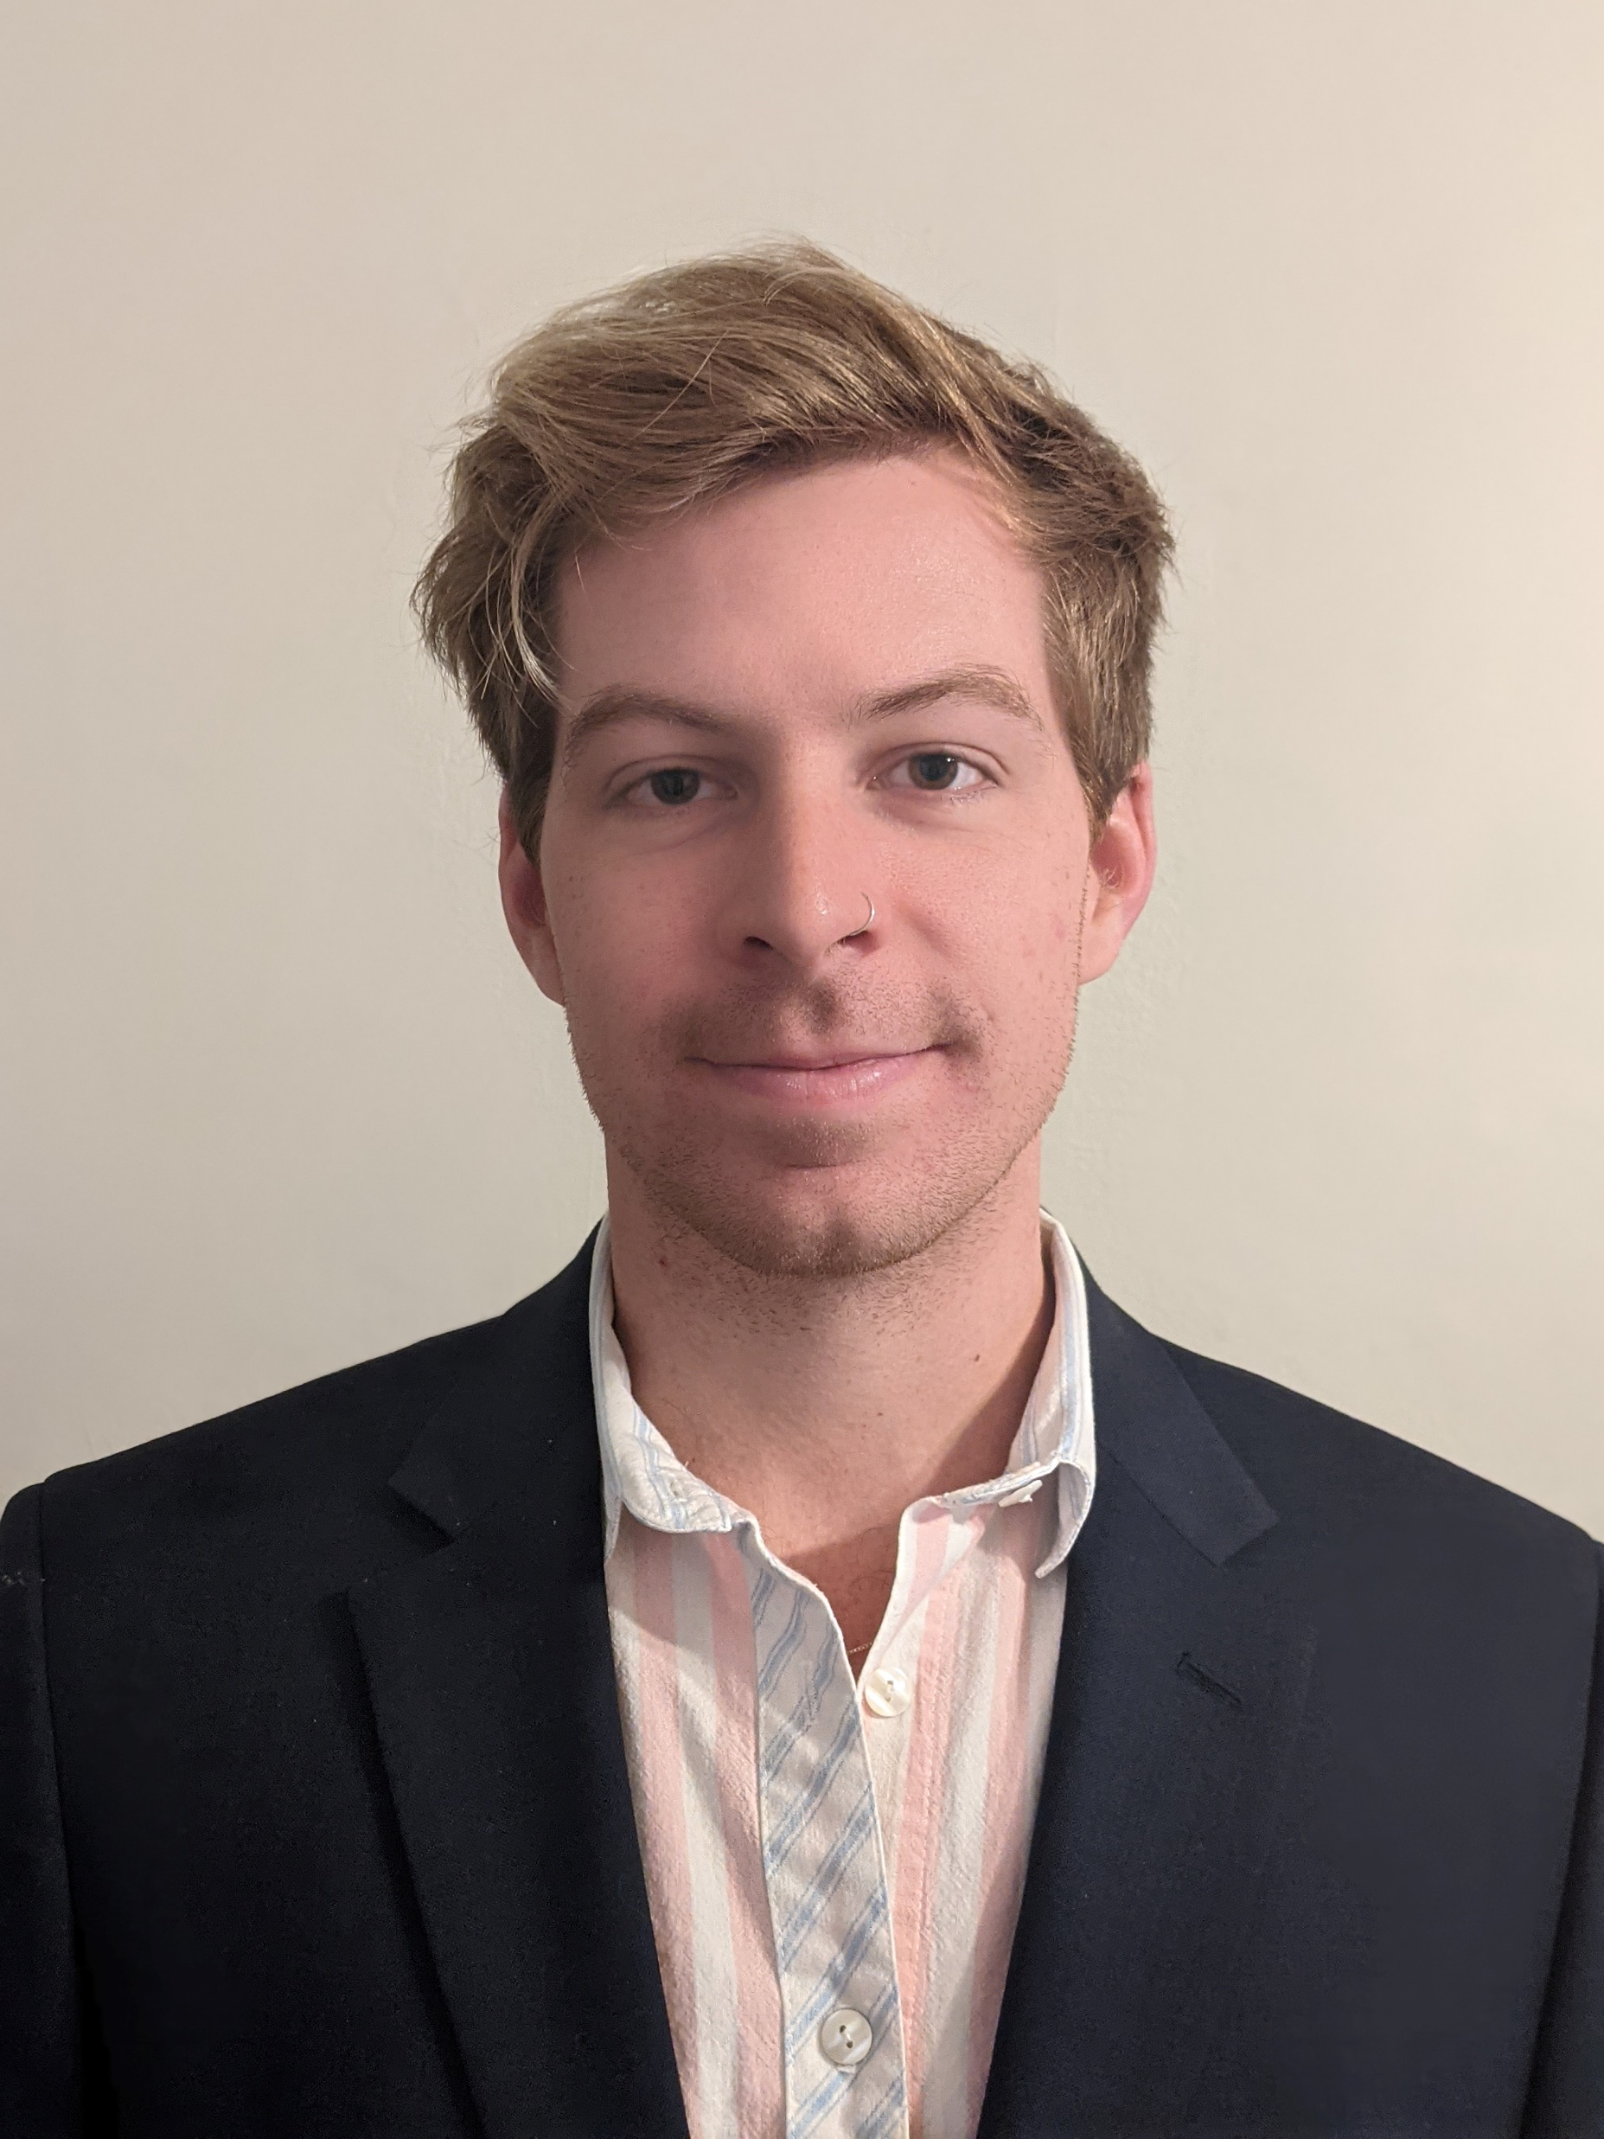
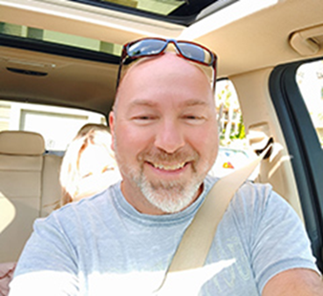

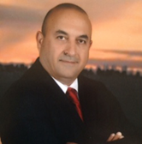
PGB EXPERT VOTING MEMBERS &
NON-VOTING MEMBERS
PGB EXPERT VOTING MEMBERS
Technical Steering Committees
PGB EXPERT NON-VOTING MEMBERS
Technical Steering Committees
Mr. Brad Bolliger
Co-Chair, NIEM Technical Architecture Committee TSC
Mr. Thomas Krul
Co-Chair, NIEM Business Architecture Committee TSC
Ms. Beth Smalley
Co-Chair, NIEM Management Office TSC
Dr. Scott Renner
Co-Chair, NIEM Technical Architecture Committee TSC
Mr. Kamran Atri
Co-Chair, NIEM Business Architecture Committee TSC
Notes:
Open Project Rules - OASIS Open (oasis-open.org)
5.1 Overall guidance for the Project is provided by its Project Governing Board (or PGB). The PGB is composed of one voting member from each Project Sponsor who elects to appoint a PGB member, and (a) if the PGB has one or more Technical Steering Committees, one voting expert representative from each TSC, elected or appointed by that TSC, or (b) otherwise, the PGB may appoint at least one and no more than two voting expert representatives from its community of contributors. The PGB may create additional non-voting PGB member seats for expert representatives to be elected by the TSC or appointed by the PGB. The PGB membership of all such members of any type is conditioned on satisfaction of the CLA requirement of Section 5.2. Voting status on the PGB may be affected by the provisions of Section 5.7.

Slide 6
Niem Model 6.0 Update
NIEM Model 6.0 PS01 published Dec 2023
16 domains
19,000 properties
10,000 types
110,000 code values
NIEM Model 6.0 PS02 pending
Minor adjustments to the structures namespace to support NDR updates
Update internal draft version numbers
Bundle submission to PGB with NDR 6.0 PSD01 in December

Slide 7
Niem API 2.0 and NIEM Toolbox – 1
Transition legacy NIEM tools into updated open source products. Move key functionality out of tools into the API for reusability.
Feature | NIEM API | NIEM Toolbox
(Background) | Java / Spring Boot and PostgreSQL database Hosted via GTRI | Nuxt (JS) SPA Hosted via GitHub Pages (free)
Transforms | Transform models into other formats Inputs – CMF or NIEM XSD Outputs – CMF, XSD, JSON Schema, or OWL Leverages the CMF tool | Form to upload file and set options API request Download results
Validation | XSD – Validate and check NDR conformance XML – Validate against provided schema CMF – Validate against schema (NTAC) IEPD catalog – Validate against schema (NTAC) XML catalog – Validate against schema (OASIS) | Form to upload file and set options API request Download and view results
Migration | Migrate from one supported model version to a more recent version Can iterate over multiple versions in one call Accepts input and generates results as CMF | Form to upload file and set options API request Download and view results
Done
In progress

Slide 8
Niem API 2.0 and NIEM Toolbox – 2
Transition legacy NIEM tools into updated open source products. Move key functionality out of tools into the API for reusability.
Feature | NIEM API | NIEM Toolbox
Model data | Return information about models, versions, namespaces, properties, classes, datatypes, and facets Supports NIEM and published community models NIEM data 1.0 – 5.2 currently available | Browse model data View information about components View information about curated list of common components
Search | Search properties, types, and codes Supports fuzzy searching, including tokens and substrings Filter results by namespace Component-specific search fields | Search models View results View information about components
Model management | Add, edit, and delete model content Model and component QA Load change request spreadsheets Generate release artifacts Generate model stats
Done
In progress

Slide 9








Resources
Follow Us On Twitter
https://twitter.com/NIEMconnects?ref_src=twsrc%5Etfw
Katherine Escobar, katherine.b.escobar.civ@mail.mil, 757-203-8631
Git Repos
NIEMOpen: https://github.com/niemopen/
NTAC TSC
https://github.com/niemopen/ntac-admin
NBAC TSC
https://github.com/niemopen/nbac-admin
NMO TSC
https://github.com/niemopen/nmo-admin
NIEMOpen Slack Channel: https://niemopen.slack.com/
Mailing Lists
NIEMOpen: https://lists.oasis-open-projects.org/g/niemopen
PGB: https://lists.oasis-open-projects.org/g/niemopen-pgb
NTAC TSC: https://lists.oasis-open-projects.org/g/niemopen-ntactsc
NBAC TSC: https://lists.oasis-open-projects.org/g/niemopen-nbactsc
NMO TSC: https://lists.oasis-open-projects.org/g/niemopen-nmotsc
https://www.niem.gov/
https://niemopen.org/
https://www.linkedin.com/groups/1903175/profile
https://www.youtube.com/channel/UCg9qV22PXLBjG41hc-EwVrQ
IEPD/MEP REPO
MEP TOOL
CMF TOOL

Slide 10
backup

